Slide 1

SKILLSBUILD FOR COLLEGES​
Edunet Foundation

Slide 2

Moving Ahead with Cloud
Introduction to Cloud Computing

Slide 3
Overview
In this module we will discuss basics of cloud computing, why business are moving on cloud , Market and Job trends in cloud computing important cloud terminologies
Notes:
Let us talk about what are we going to discuss in this module.
In this module we will discuss about basics of cloud computing, why business are moving on cloud , Market and Job trends in cloud computing , important cloud terminologies, what is Microsoft Azure , What can you do with Azure , What is Azure portal, How to get started with the Azure Platform.

Slide 4
Agenda
Why and What is Cloud Computing?
Cloud Architecture
On-premise vs Cloud model
Cloud Key Terminologies
Market Trends
Characteristics of Cloud Computing
Advantages of Cloud Computing
Notes:
Our Agenda for the following session is our discussion on:
Why and What is Cloud Computing?
Cloud Architecture
On-premise vs Cloud model
Cloud Key Terminologies
Market Trends
Characteristics of Cloud Computing
Advantages of Cloud Computing

Slide 5

Why Cloud Computing?
Scenario: There is a small software development firm, and they want to expand the business due to rapid increase in their users.
For that, they need to set up entire infrastructure by buying physical Servers and other Computing resources.
But, Buying and understanding the entire set up would be :
Time Consuming and Costly
Requires Physical Space with sufficient power and cooling
Notes:
Cloud computing is considered the latest technology that gives enough flexibility in terms of infrastructure, cost and speed. Most of the companies are now migrating their applications and data to the cloud. Let's try to understand why do we need cloud computing with the help of this simple scenario. Let's have a look at this scenario.
Let's say, there is a small software development firm, and they want to expand their business due to rapid increase in their users.
But wait, For that, they need to set up entire infrastructure by buying physical Servers and other computing resources.
So, Buying and understanding the entire set up would be:
Time Consuming and Costly
Requires Physical Space with sufficient power and cooling

Slide 6
Why Cloud Computing?
Maintain and manage them requires experts
Acquire maximum computing resources than needed.
Ending up with less utilization.
Focusing more on troubleshooting at the infrastructure level than the end business goal.
Notes:
Maintaining and managing the infrastructure requires technical experts
May be, they end acquiring maximum computing resources than the actual need that can lead to underutilization of the resources and increase in upfront cost.
They end on Focusing more on troubleshooting at the infrastructure level than the end business goal.
Can there be a possible solution? Yes there is one.

Slide 7

Solution: Cloud Computing
No need to buy new resource every time.
Global accessibility of resources.
Ready to use set up.
Availability
Pay as you go
Fault Tolerance
solution
Notes:
Cloud Computing comes to rescue in these scenario and that is why we need Cloud Computing today. But How ?
Because with Cloud Computing:
There is no need to buy new resource every time, you can easily rent out computing resources for the time you need them.
There is Global accessibility of resources meaning you can use your virtual resources from anywhere and you can also deploy your application in the global regions.
It is Ready-to-use set up. Computing resources can be acquired on-demand from anywhere and anytime in matter of seconds.
Highly Availability; Cloud makes our application and data to be highly available for our end users based on the requirements.
Pay as you go: Pay for only those resources that you are using and for the time you are using them. There is no upfront cost associated.
Fault Tolerance: cloud has the Ability to withstand certain amount of failure and still remain functional which makes your application safe and secure and you need not to worry about data loss.
These points definitely make anyone curious about cloud computing.
To understand it better let's see what is cloud computing.

Slide 8
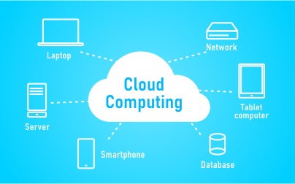
What is Cloud Computing?
Cloud computing is the on-demand delivery of computing resources including servers, storage, databases, networking, software, analytics, intelligence over the internet on pay as per use basis.
It eliminates the need for the enterprise to procure, configure and manage the resources and they can focus on business goals.
https://www.thinkitsolutions.com/wp-content/uploads/2019/04/what-is-cloud-computing-with-example-300x187.png
Notes:
To define Cloud Computing, it can be summarized as:
Cloud computing is the on-demand delivery of computing resources including servers, storage, databases, networking, software, analytics, intelligence over the internet on pay as per use basis.
It eliminates the need for the enterprise to procure, configure and manage the resources and they can focus on business goals.

Slide 9
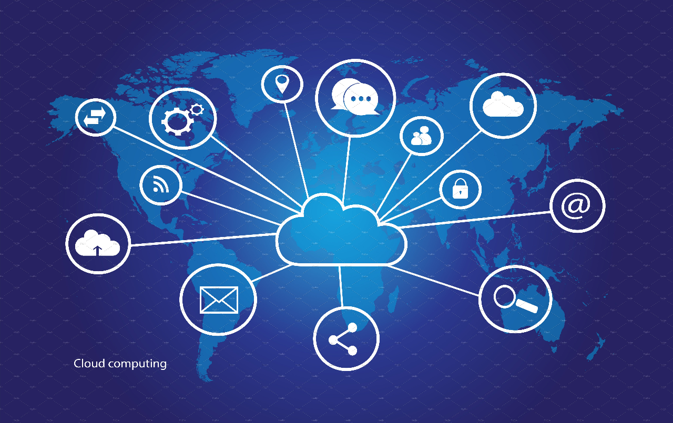
Applications of Cloud Computing
App Management
Backup and storage
Content delivery
Websites
Database
Enterprise IT solutions
Backup and storage
cloud applications
Notes:
Let us see some of the applications of cloud computing.
•App management– It can be used for developing and deployment for your application.
•Backup and storage –It is used for backup and storage purpose of your files, databases, your photographs and every type of data.
•Content delivery- In would be used for content delivery across the Internet
•Websites- With cloud , we can design , develop and deploy the websites easily.
•Database – We can store and access structured and unstructured data on the cloud.
•Enterprise IT solutions – Cloud is useful for designing and maintaining the Enterprise IT solutions. Enterprises such as banking system, railways, airline system, booking management systems; all uses these solutions.

Slide 10
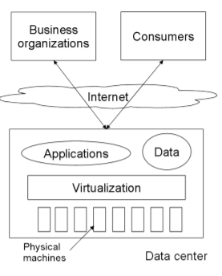
Cloud Architecture
Basics Cloud Computing Architecture
Notes:
As you can see in the diagram.
In cloud architecture, datacenter consists of all the physical machines and networking components. You can host your applications or store your data on these machines easily and can later on access your application or data from anywhere over the internet with the help of virtualization.

Slide 11
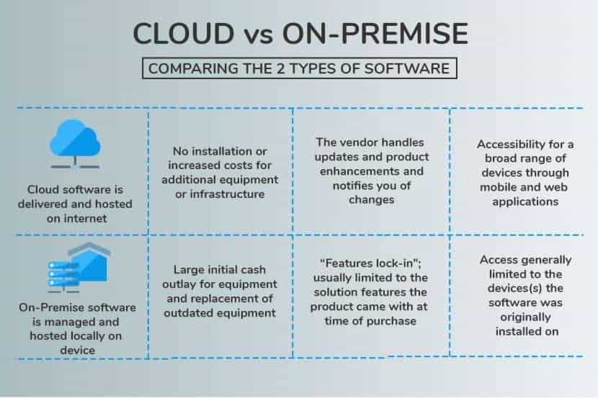
On-premise vs Cloud
https://images.app.goo.gl/cAh3AV1dnYvebKAc6
Notes:
To understand better let's look into the differences between On-premise and Cloud based system.
Cloud Software is delivered and hosted on internet Where is On premise software is managed and hosted locally on devices.
Secondly, in case of cloud computing there is no installation or increased cost for traditional equipment or infrastructure where as in case of on premises system you would need large initial cash outlay for equipment and replacement of outdated equipments. So, in cloud there is no upfront cost.
Also, in case of cloud computing, the vendor handles the updates, product enhancements and notify you of any changes. This makes a huge effect where as in case of on premise system, the issue is with the features locking which means it is usually limited to the solution features the product came at the time of purchase.
In case of cloud computing, accessibility of a broad range of devices through mobile and web application is possible meaning you can access your applications and data from any device like you can access your email from any device if you have your credentials with you where as for on premise system, access is generally limited to the devices the software was originally installed on, meaning access is limited to the device on which you have installed the software.

Slide 12
Cloud Key Terminologies
As a service (-aas)
Cloud services
Cloud native
Content delivery network
Multitenancy
Scalability
Elasticity
Serverless
Virtualization
Notes:
So we have a lot of terminologies in Cloud domain. Let us discuss about the frequently used terminologies of cloud computing:
As a service (-aas) : This is a common term used for services which are now provided as cloud computing services like Infrastructure as a service, platform as a service and Software as a service.
Cloud services : The services that are provided over cloud.
Cloud native : The applications or services or environment that is exclusively for cloud or which resides in cloud are called as cloud native.
Content delivery network : also known as CDN is a network specially designed to cater the need of consumers. It is a network which makes it possible to transfer data from servers to clients with minimum delay.
Multitenancy: The cloud resources are provided from a shared pool. This also means a resource would be allocated to multiple users or tenants.
Scalability: A resource or service can be scale up or down as per requirement.
Elasticity: One of the great characteristic of CC. Most of the resources are elastic in nature which means they would return to their original state as soon as the work is done.
Serverless : A few services or applications natively need a dedicated server to run on. However, with the wonders of CC we do not require dedicate servers for the same. The same set of services can be provided. These are called as serverless services or applications.
Virtualization: This is the backbone of Cloud Computing. Since every service is provided virtually to users, virtualization is the concept that makes it possible. We would discuss more about virtualization in upcoming modules.

Slide 13
Characteristics of Cloud Computing
Broad network access
Rapid elasticity
Measured service
On-demand self service
Resource pooling
Notes:
Now let's look into the characteristics of cloud computing.
Do remember, these characteristics are defined by NIST in year 2011 and they are still relevant.
First one is Broad network access
You can access the cloud computing resources through Internet or private network.
Anyone with a laptop, table, or cell phone should be able to access the computing resources.
Second, it must have Rapid elasticity, which means:
Computing resources may scale up and down rapidly in event of spikes or dips in the traffic.
Not all cloud services come with this automatically. Rather, it often needs to be customized by the customer.
Third, Measured service
Cloud Provider measure or monitor the service for the multiple reason like billing, effective use of service and planning purposes.
Metrics should have been defined.
The most common metrics used to measure services are time and number of users.
Next, It should be an On-demand self-service
End user should be able to provision computing resources by themself.
Earlier, every request was provision by vendor. Thus, time consuming and not cost savvy.
Fifth is Resource pooling
multiple users would be using the same pool of resources.
This increases energy saving.
Although not preferred, It is also possible to get a dedicated machines, called bare metal or dedicated instance.

Slide 14
Advantages
Lower computer costs
Improved performance
Reduced software costs
Unlimited storage capacity
Increased data reliability
Universal Information Access
Device Independence
Notes:
The advantages of cloud computing is much more than what we can discuss here but to have a brief view let's look into some.
Such as
Lower computer costs
No need of a high-powered and high-priced equipment.
A simple netbook is sufficed.
Also there is no need of buying expensive software.
Improved performance.
No need of memory consuming software.
Local machine eventually perform better.
One of the best advantages of cloud computing is the reduced software cost you don't have to buy a new software every time, other than that there are few other things such as
You would get Basic software in bundle package.
You would also have better functionality with web-based software like Office 365, Google docs.
The cloud computing gives you a practical unlimited storage capacity.
the storage capacity can be increased as per requirement, on the go.
The cloud computing increases data reliability now you don't have to worry when your local computer crashes because it is not going to affect the storage of your data.
Since your document would be stored somewhere in cloud, they would be universally accessible.
Also since you are no longer limited to a single system or a single network you can actually access all your documents services and application from any device there is no need to log into the same device every time to have these services.

Slide 15
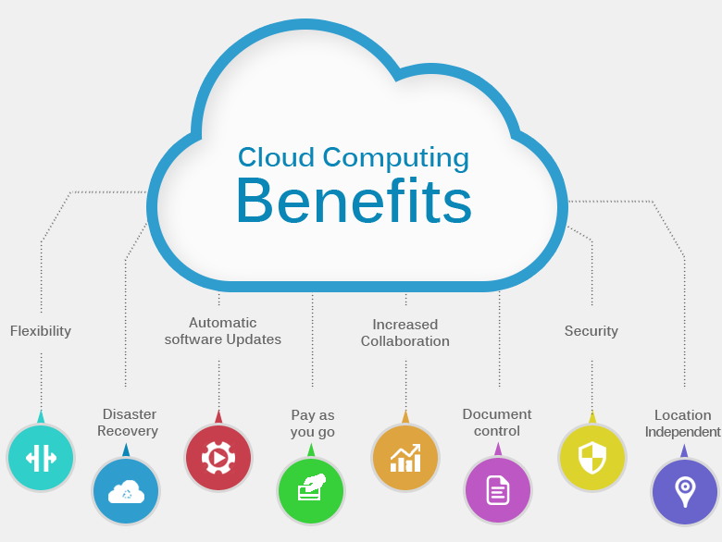
Why are Businesses migrating to Cloud ?
Cloud Computing benefits
Notes:
As most of the organizations are migrating to cloud. So we need to understand the reason behind it.
Following can be the benefits of cloud that are contributing for this :
1.Flexibility Cloud-based services are ideal for businesses with growing or fluctuating bandwidth demands. If your needs increase, it’s easy to scale up your cloud capacity, drawing on the service’s remote servers. Likewise, if you need to scale down again, the flexibility is baked into the service. This level of agility can give businesses using cloud computing a real advantage over competitors.
2. Disaster Recovery Businesses of all sizes should invest in robust disaster recovery, but for smaller businesses that lack the required cash and expertise, this is often more of an ideal than the reality. Cloud computing is now helping more organizations buck that trend.
3.Automatic Software update: The one of the main benefit of cloud computing is that the servers are off premises, out of your sight. Suppliers take care of them for you and roll out regular software updates—including security updates—so you don’t have to worry about wasting time maintaining the system yourself. This leaves you free to focus on the things that matter, like growing your business.
4.Pay as you go :
Cloud computing cuts out the high cost of hardware. You simply pay as you go and enjoy a subscription-based model that’s kind to your cash flow. Add to that the ease of setup and management, and suddenly your scary, hairy IT project looks a lot friendlier. It’s never been easier to take the first step to cloud adoption.
5.Increased Collaboration When your teams can access, edit, and share documents anytime, from anywhere, they’re able to do more together and do it better. Cloud-based workflow and file-sharing apps help them make updates in real time and give them full visibility into their collaborations. 6.Document Control The more employees and partners collaborate on documents, the greater the need for watertight document control. Before the cloud, workers had to send files back and forth as email attachments to be worked on by one user at a time. Sooner or later—usually sooner—you end up with a mess of conflicting file content, formats, and titles. And as even the smallest companies become more global, the scope for complication rises. According to one study, “73% of knowledge workers collaborate with people in different time zones and regions at least monthly.”
When you make the move to cloud computing, all files are stored centrally and everyone sees one version. Greater visibility means improved collaboration, which ultimately means better work and a healthier bottom line.
7.Security Lost laptops are a billion-dollar business problem. Potentially greater than the loss of an expensive piece of kit is the loss of the sensitive data inside it. Cloud computing gives you greater security when this happens. Because your data is stored in the cloud, you can access it no matter what happens to your machine. You can even remotely wipe data from lost laptops so it doesn’t get into the wrong hands.
8.Location Independent: With moving to the cloud, if you’ve got an internet connection, you can be at work. And with most serious cloud services offering mobile apps, you’re not restricted by which device you have on hand.

Slide 16
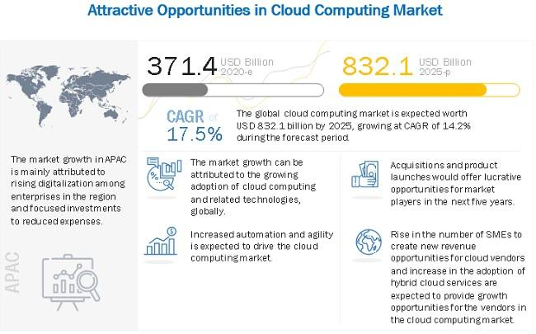
Market Trends
T811175985_g.jpg (650×405) (openpr.com)
Notes:
You can observe from the slide that the market of cloud is not only thriving and predicted to stay in boom in the upcoming future.
So as you can see here in the year 2020, the market of cloud computing was 371.4 billion dollar And by the year 2025, it is expected to rise up to 832.1 billion dollar. As per the report of CAGR Every year It is expected to have 4.2% growth in the cloud market.
They are also told us the market growth can be attributed to the growing adoption of cloud computing and related technologies globally.

Slide 17
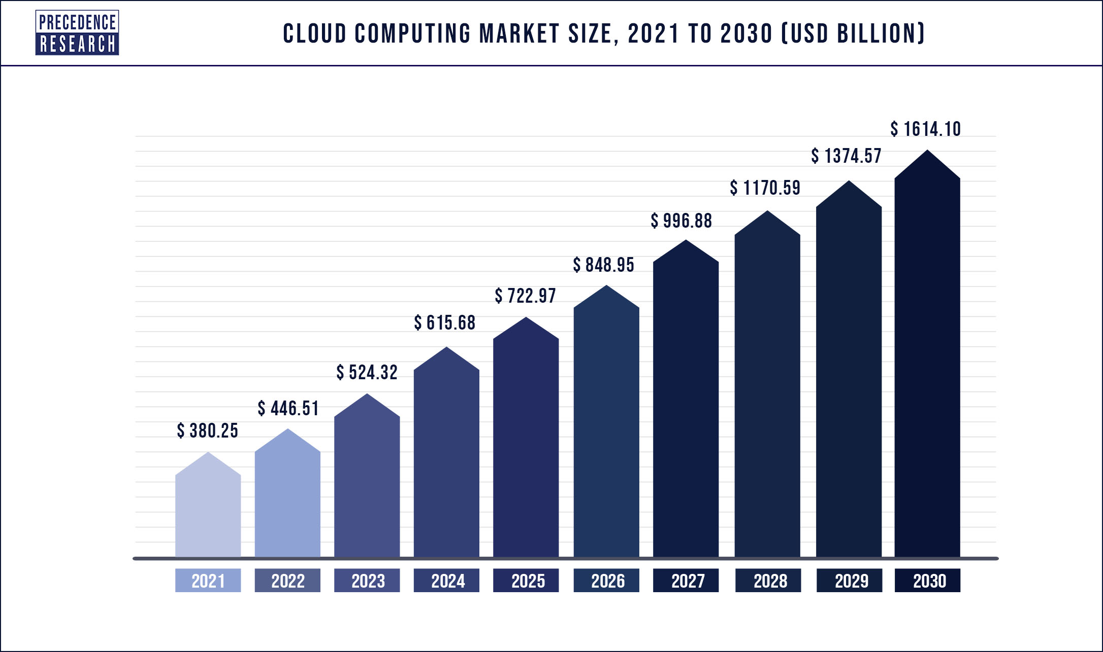
Market Trends
Cloud-Computing-Market-Size-2021-to-2030.jpg (2172×1286) (precedenceresearch.com)
Notes:
Another example of the same.
This picture would give you a fair idea of the increase of the cloud computing market size.
As you can see from the year 2021 to 2030, we are going to expect a gradual increase in the cloud market.
in year 2021, the market was saturated at $380.25 billion well it is going to be as high as $1834 billion by the year 2030.

Slide 18
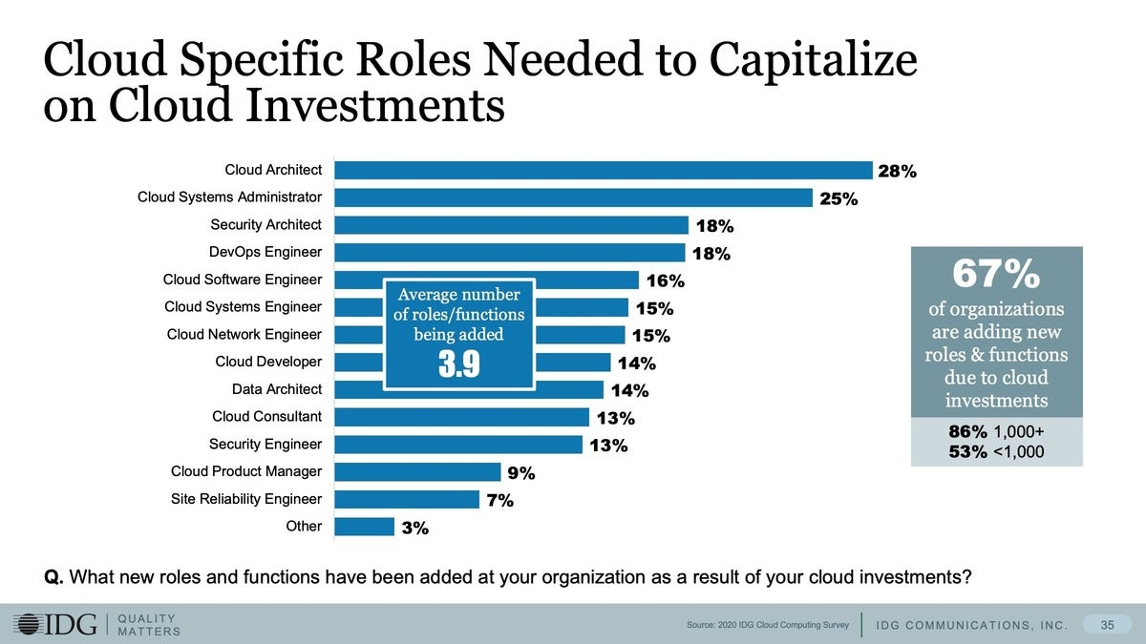
Job Trends
job roles in cloud computing 2022
Notes:
As per the Economic Times Jobs, India was expected to see over 1 million cloud computing job roles by 2022.
As of now, cloud computing has become critical aspect of new age technology stack. For every business , cloud is becoming part of their solution either in the form hybrid model or full- flagged migration of their hosted services.
This is the time you can comprehend why cloud is essential skill that one can have and why you can choose this as your career. Answer is, It will generate huge opportunities for you.
As we can see in the slides there are number of cloud specific roles that you can get based on your skills and interest in the cloud computing technology.

Slide 19

Cloud Security
With the adoption of the best practices the cloud providers are ensuring cloud security. Some of them are listed below:
Shared Responsibility between cloud provider and the customer
Data Encryption
User Identity and Access Management
Collaborative Management
Monitoring of cloud services
cloud security
Notes:
As organization are migrating their applications and data to the cloud. Security can be big concern for the customers but cloud providers are ensuring security on the cloud by adopting some of the best practices.
Sharing Responsibility for Security between cloud provider and the customers: Generally, cloud provider is responsible for the infrastructure and customer is responsible for protecting data within the cloud. Data ownership should be clearly defined between private and public third parties in order to keep your data secure over the cloud.
Data Encryption: Data should be encrypted while in use, transit or rest. Customers should have full control over security keys.
User Identity and Access Management: Customer and IT teams need full understanding of and visibility into network, device, application, and data access. Only authorized person should be given access to the data within cloud. Roles should specified properly.
Collaborative Management: There should proper collaboration between IT, operations and security teams that will ensure seamless cloud integration that are secure.
Monitoring of cloud services : Active monitoring of cloud-based services helps to maintain visibility of all data exchanges between public, private, and hybrid cloud environments.

Slide 20
THANK YOU

Slide 22
Title
Source: https://www.ibm.com/academic/home

